Slide 1
Practical Tips When Working In CLUWE
Qing
Mar XX, 2017 SA XXX

Slide 2
Meeting Agenda
A Little Macro:
Search and Replace on Folder Level
About EG:
Project in EG
Log
Version Control
Tips and Tricks
Third-party Software
WinSCP

Slide 3
Search and Replace on Folder Level

Slide 4
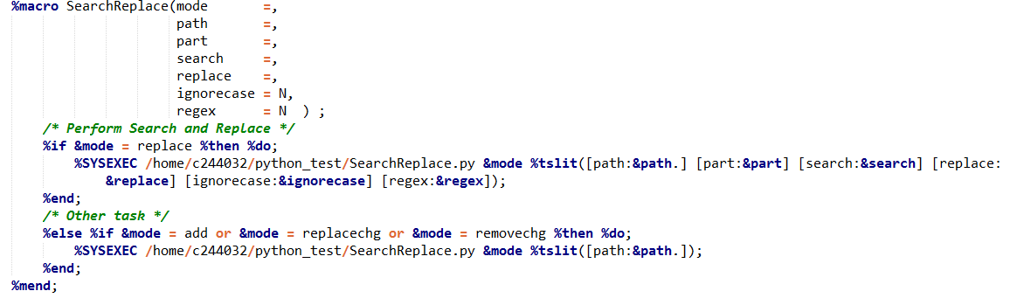
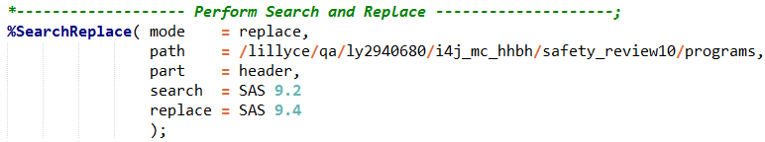


The Code and Instruction
replace or removechg or replacechg
SAS program location
header or program or all
Search contents
Replace contents
Modifier. If = Y, ignore case when search
Modifier. If = Y, Per regular expression is enabled

Slide 5

Key Feature
Folder Level Search and Replace
Differentiate Between Header and Program
Regular Expression Enabled

Slide 6
Working Flow
%SearchReplace
Is _chg File Exist?
Repeat
Yes
No
Change to _chg File
Change to Original File
End
Replace Original Program with _chg Program

Slide 7
Demonstration

Slide 8
EG:
Project in EG
Log
Version Control
Tips and Tricks

Slide 9


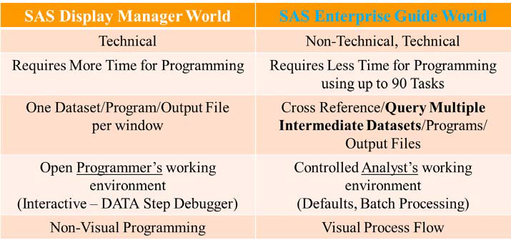
SAS DISPLAY MANAGER VS SAS ENTERPRISE GUIDE

Slide 10
What’s lost in EG
Feature | Application | Work-around
DM Command | Control SAS Display Manager GUI Log clear; output clear | System defined Task & Custom defined Task
SAS/AF | Object oriented application development | Use prompts – Microsoft Visual Studio programming
Macro Window | %WINDOW-statement: macro variable prompts during program execution | Use Prompt Manager
Catalog Browser | Format Catalog, Macro Catalog | Download custom task Catalog Explorer
DDE | Dynamic data exchange from and to Microsoft Excel | import/export tasks, ODS ExcelXP
YOU LOSE SOME TIME FOR TRAINING Besides, The EG is generally slower than PC SAS

Slide 11
The Project in EG

Slide 12
What is the Project in EG?
A project is an organized collection of code, datasets, logs and output
It’s the core concept in Enterprise Guide
Two Main Component: Project Tree Process Flow
Enables you to keep all the pieces of your project organized and accessible from a single location.
Allows it to be shared easily within a team

Slide 13
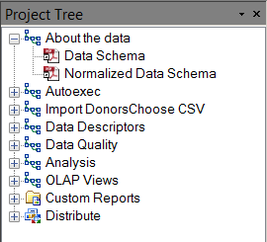
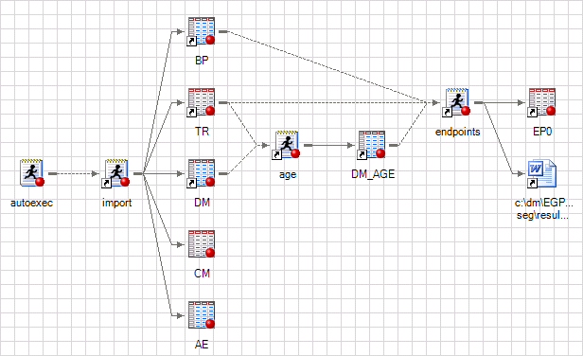
Project Tree & Process Flow
document
Set up
Different process flow
Project Tree
Process Flow

Slide 14
Project
How can we benefit from Project?

Slide 15
The LOG
Source:

Slide 16
Log is Different
We must use Proc Printto statement to export log file. Dm “log;file” is no longer useful
However, if we use Proc Printto, log will disapear in Log Window.
In order to fix this issue, %ut_saslogcheck has a ability to sent log back to Log Window using put statement

Slide 17
Version Control in EG
Source:

Slide 18

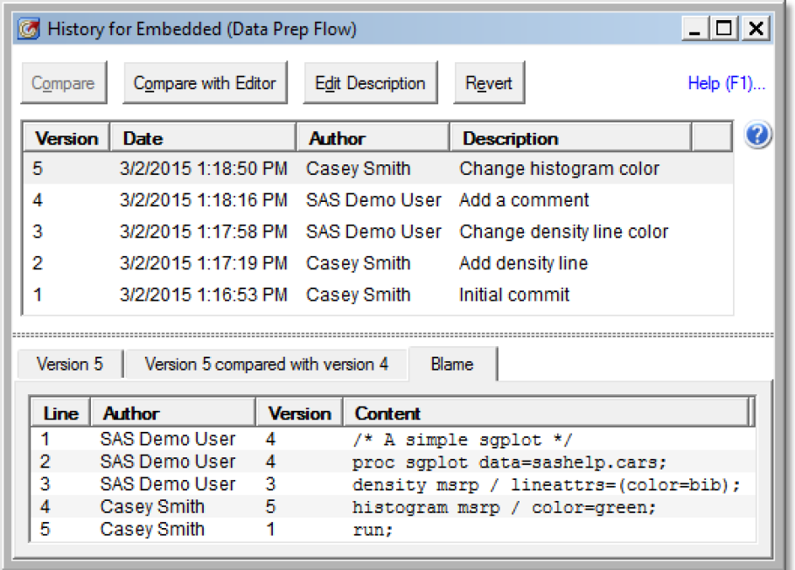
Why We Need Version Control?
To Restore Program in Accidence
To Keep Track of Program Change

Slide 19
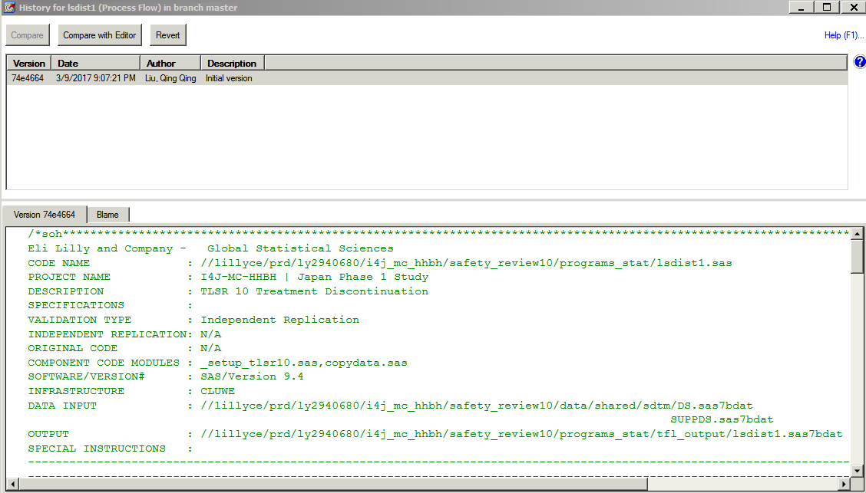
Version in EG

Slide 20
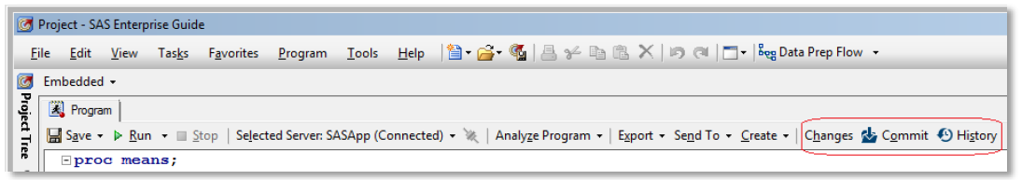
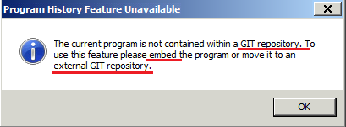

How to Version
What is a GIT repository?

Slide 21
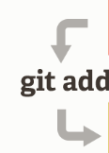



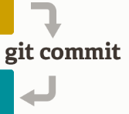


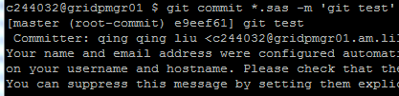
GIT
GIT 是目前世界上最先进的、最流行的分布式版本控制系统
Linux默认安装
git init

Slide 22
Tips and Tricks
Source:

Slide 23
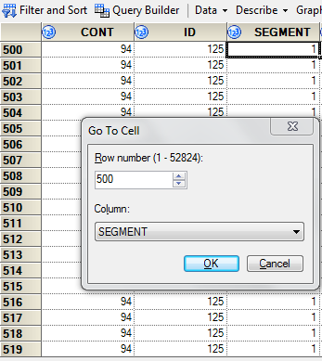
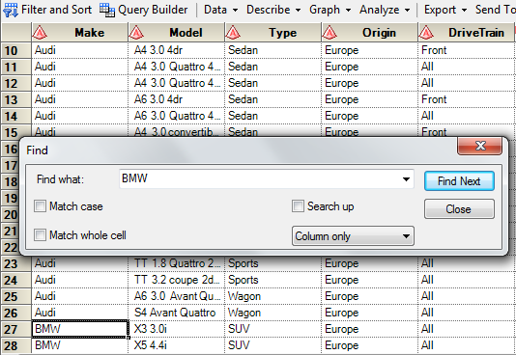
Tips: Go to specific row & find in Data View
Ctrl + G
Ctrl + F
Tips: Ctrl + End > Last Record; Ctrl + Home > First Record

Slide 24
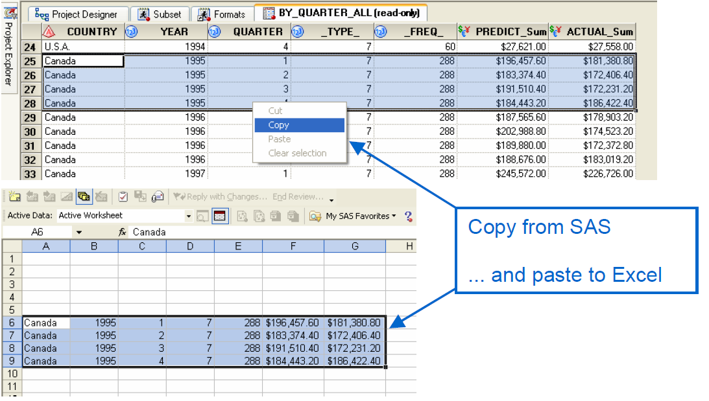
Tips: Copy and Paste a Block of Data
Source:

Slide 25
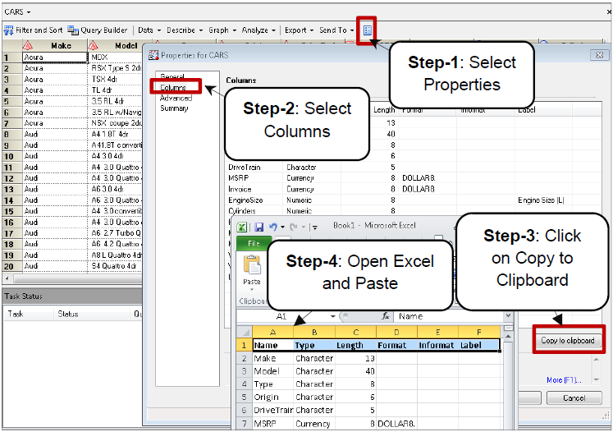
Tips: Dataset Proc Contents
Source:

Slide 26
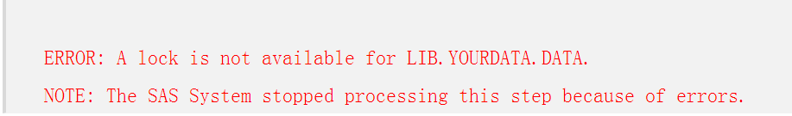
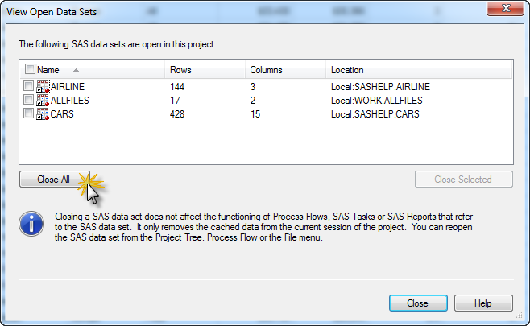
Tips: Closes All Datasets
Tools
View Open Data Sets

Slide 27
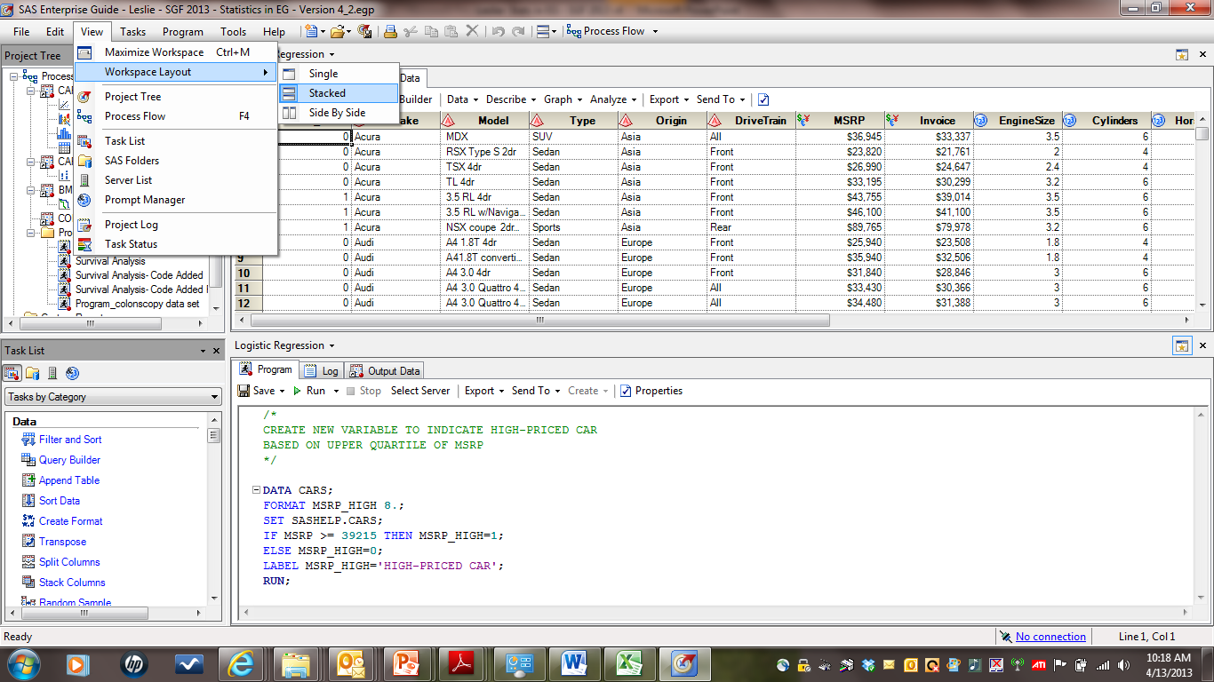
Tips: WORKSPACE
Tips: You can arrange your workspace either by Stacked or by Side By Side
Tips: The workspace can’t divide up your windows by monitor, SAS R&D team is exploring for a future release.

Slide 28
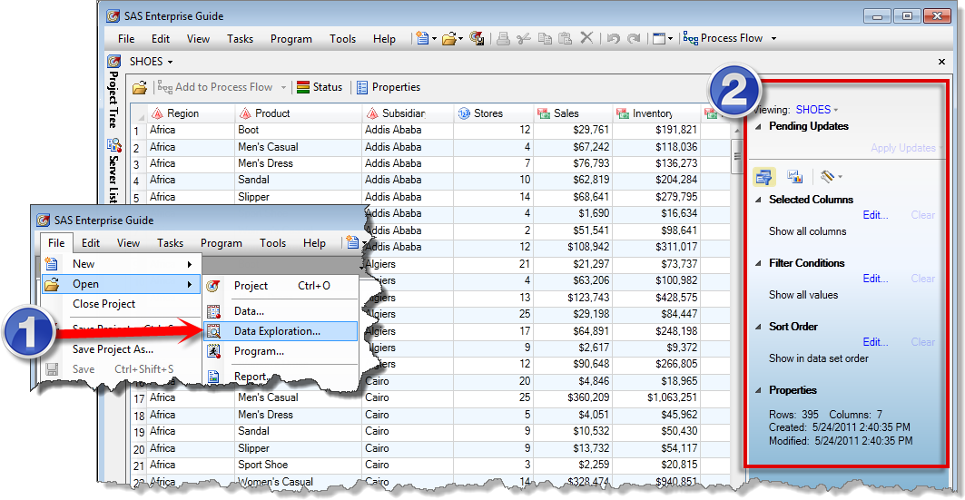
Tips: Data Exploration
Tips: The Data Explorer doesn’t work for WORK Library, however you can do this tricks: libname explorer &sasworklocation;

Slide 29
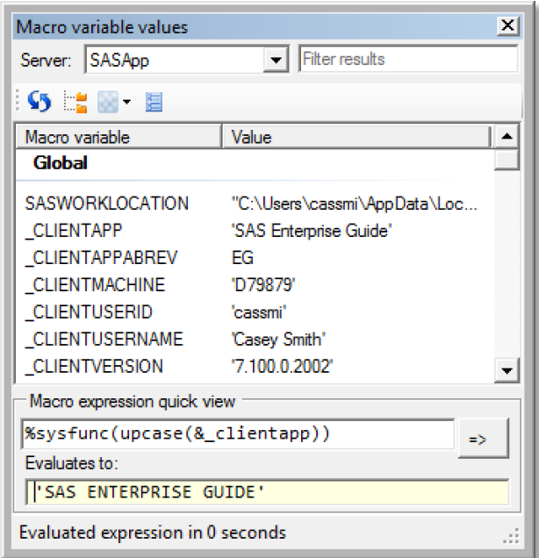
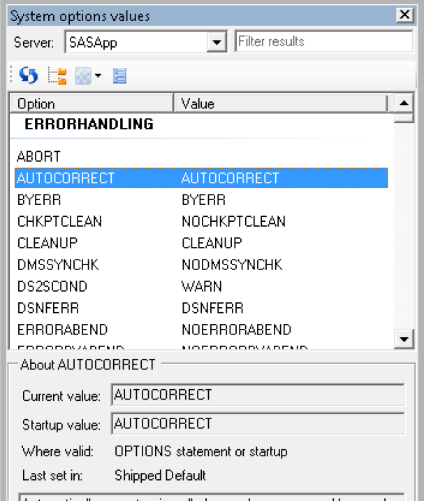
Tips: Two kinds of Viewer
Macro Variable Viewer
System Options Viewer

Slide 30
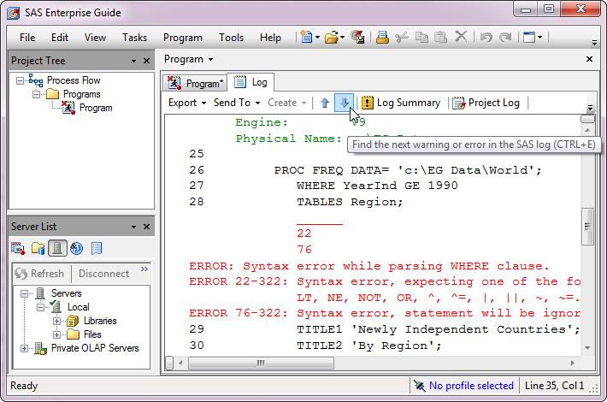
Two types of Log:
Program Log
Tips: Program Log is auto-cleaned every time you run program

Slide 31
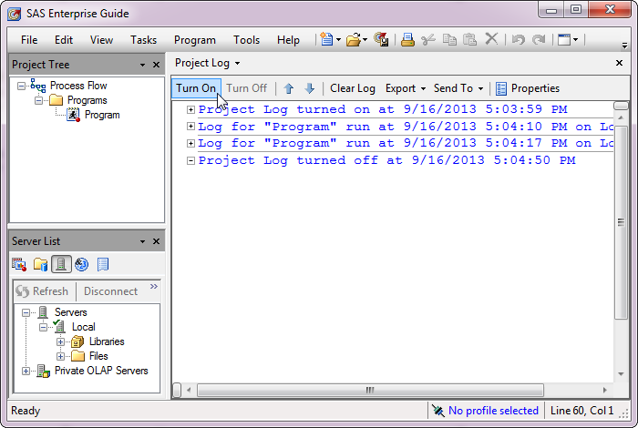
Two types of Log:
Project Log
Tips: Project Logs are continuous, until turned off or cleared by user

Slide 32
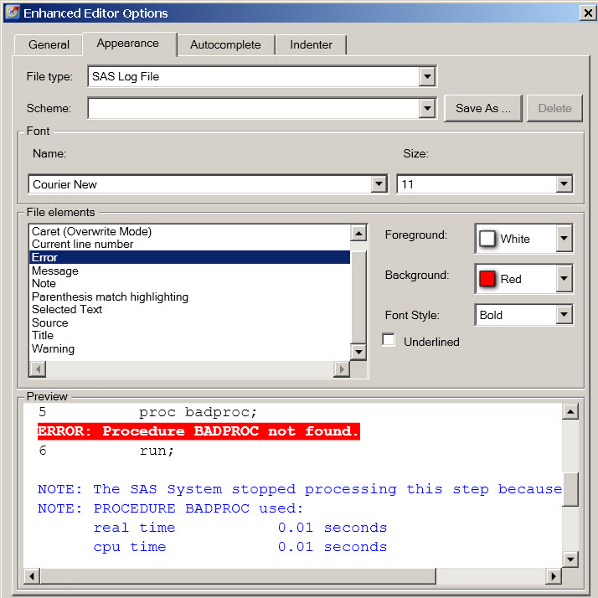
Tips: Editing Log Color to traditional SAS Color
Tools
Options
SAS Programs
Editor Options
Apperance

Slide 33
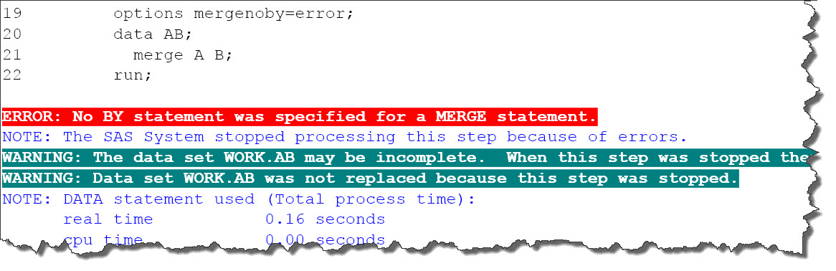
Tips: Editing Log Color to traditional SAS Color

Slide 34
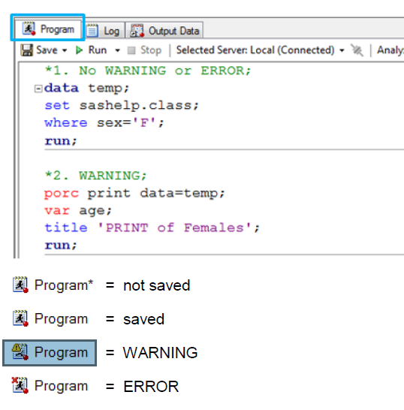
Tips: Using Visuals

Slide 35
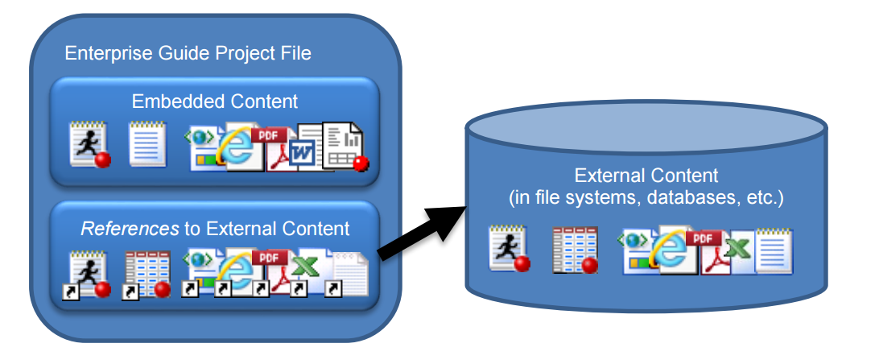
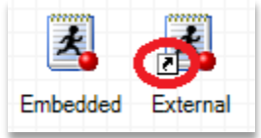
Project Format
Tips: Embedded Content reside in .EGP File, No external file will exist
External Content reside in external

Slide 36
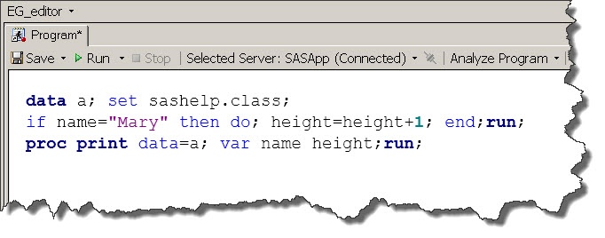
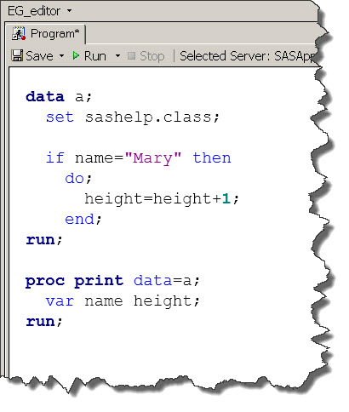
Tips: Format Code
Right Click Program
Format Code

Slide 37
Remote File Management WinSCP
Source:

